Slide 1

Helping Children Learn
Meta-cognition and use of talk
Mediate learning
Lucy Manger
Beth Turner
Rebecca Blyth
Hampshire Educational Psychology

Slide 2
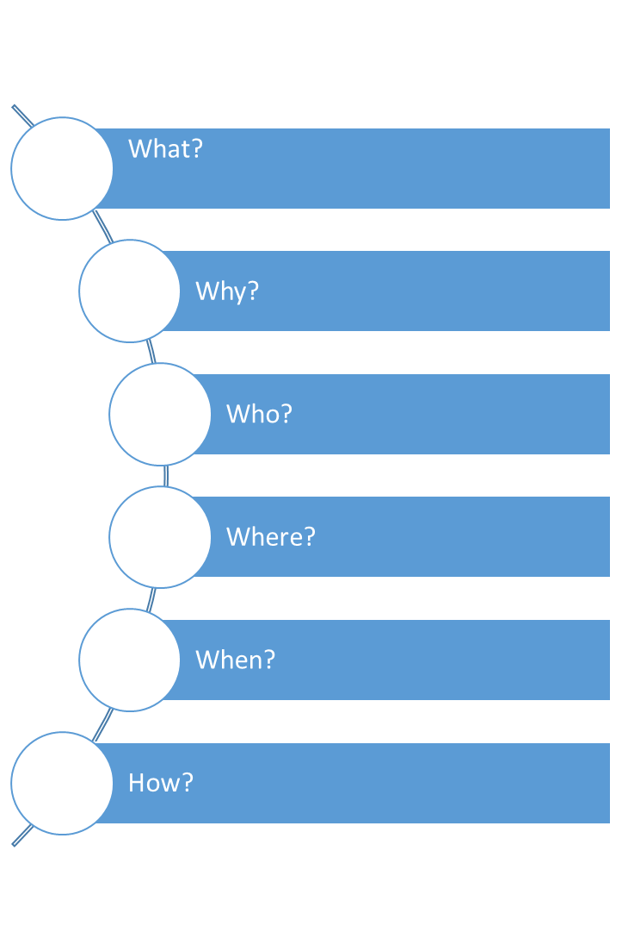
Outline
Hampshire Educational Psychology
Notes:
What is mediated learning/metacognition?
Why is it important?
Who can it benefit?
Where can it be used?
When can it be used?
How can it be used?

Slide 3


The six oranges puzzle
There are six oranges in the bag. How can you give these six children an orange each and still have one left in the bag
Hampshire Educational Psychology

Slide 4

Think about the SATs experience, with a partner reflect on the factors you think might aid a successful outcome?
If adults weren’t there, would this learning take place?
Hampshire Educational Psychology
Notes:
Generation of ideas; such as emotions, motivation, ‘intelligence’
Reflect on factors involved in successful learning in a wider context
Reflect on the adult role - if teachers weren’t there, would this learning take place?

Slide 5
How we learn
Cognitive processes
Feelings &
motivation
Metacognitive skills
Physiology/
neurology
Mediated learning experience
Hampshire Educational Psychology
Notes:
Links to prior slide
Focus on metacognition within the mediated learning experience.
Learning is not just about how ‘intelligent’ you are – it encompasses all of these things.

Slide 6

Cognition
Metacognition
Hampshire Educational Psychology
Notes:
What are the important terms? Write down what you know about these terms already. (refer to handout)
Cognition – group of mental processes including attention, memory, producing and understanding language, thinking, solving problems, making decisions
Metacognition – being aware of
our own learning

Slide 7

Feelings and motivation
Locus of control
Fear of failure/defensiveness
Confidence in correct responses
Vitality and alertness
Accessibility to mediation
Need for mastery/intrinsic motivation
Frustration tolerance
Hampshire Educational Psychology

Slide 8

What do we mean by “mediated learning”
MLE is a special quality of interaction between an adult, a learner and task
Hampshire Educational Psychology
Notes:
Impacts on all three things: feelings & motivation, cognition and metacognition. E.g: feelings of competence, overlearning etc.
What is the role of the adult in this process? If teachers weren’t there, would this learning take place?

Slide 9
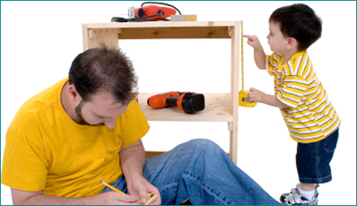
Why should we be interested in MLE?
It is the cause of individual differences in cognitive development
Within child and environmental factors are secondary
MLE (or its lack) is the primary reason for learning difficulties
Hampshire Educational Psychology
Notes:
Link with metacognition

Slide 10

Who is a mediator?
Hampshire Educational Psychology
Notes:
It can be anyone that consciously or unconsciously is developing a child’s cognitive processes with the goal of assisting the child become an independent learner

Slide 11

How does MLE work?
Task Learner Response
Hampshire Educational Psychology
Notes:
Learning without an adult/mediator – link to Piaget

Slide 12
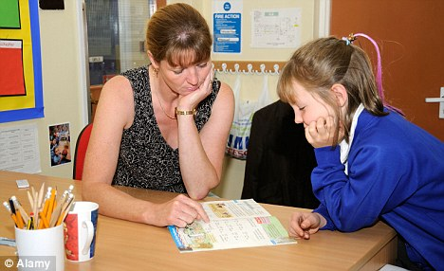
How does MLE work?
Mediated learning
Task➔Adult➔Learner➔Adult➔Response➔Adult
Hampshire Educational Psychology
Notes:
In order for metacognition to come into play the adult needs to come in at the end of the process as well as at the beginning – a sort of adult mediated review.
Look at Plan, Do, Review image in worksheet – point out where adult input would come in order to make it a mediated learning experience and to allow for metacognition. The better we are at this process the less we need mediation because the child internalises the metacognition, self-talk and strategies. The mediated learning experience leads to more effective metacognition, and if we just stick at the task-learner-response approach we limit the ability to generalise, because it means that you always have to present a task as a stimulus. It is only if the child develops these skills for themselves will they be able to do it by themselves.
Link to generalisation, bridging into other activities/tasks

Slide 13
Traditional assumptions about learning | Assumptions about learning from cognitive psychology
Focus on content and acquiring knowledge | Focus on learning how to learn
Learning is a product | Learning is a process
Instructor | Mediator
Hampshire Educational Psychology

Slide 14
Intelligence is: | Cognitive processes are:
Largely genetic (inherited) | Taught and learned
Related to a range of aptitudes (verbal, spatial, numerical) | Influenced by some fundamental competence and by learning and problem solving habits, motivation, attitudes and strategies
Largely fixed | Modified through mediated learning experience
Linked to the ability to learn culturally based knowledge | Generalisable across domains of knowledge
Hampshire Educational Psychology
Notes:
Drawing out the idea that learning is a process and involves another of factors, as highlighted. Successful learning can be applied to other tasks/domains. The role of mediation is to ultimately get the learner to internalise the skills of metacognition.

Slide 15

The point is, that what I can do today with your help, I can do by myself tomorrow – assuming that you have provided a MLE
Hampshire Educational Psychology

Slide 16
Back to the six oranges puzzle
Hampshire Educational Psychology
Notes:
Explain your solution to someone else.
Is it acceptable?
How did you think about it?
If you couldn’t think of a solution, why not?

Slide 17
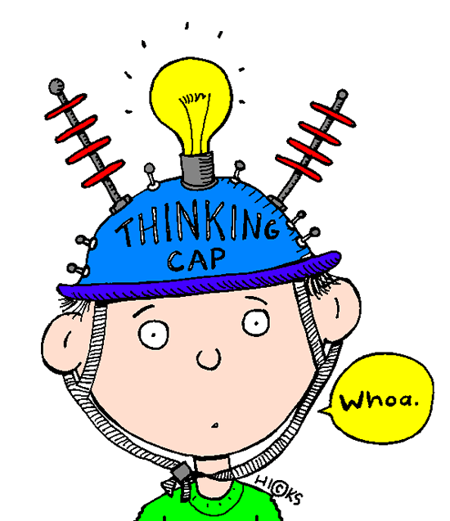
Reflecting upon learning
What did you learn recently?
Why did you learn it?
How did you learn it?
How do you know that you learnt it?
Hampshire Educational Psychology
Notes:
Metacognition. REVIEW part of “plan, do, review” process.
Task: ask everybody to discuss with a partner these questions.

Slide 18
Solving a reasoning problem
Work with a few people
Can you solve this problem?
How did you solve it?
What helped you solve it?
Hampshire Educational Psychology
Notes:
You are about to see a problem that involves reasoning (by inference)

Slide 19
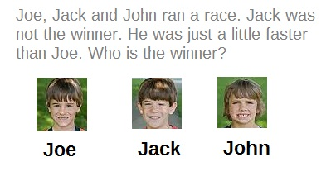
Hampshire Educational Psychology
Notes:
Change image to another reasoning problem – clearer pic.

Slide 20
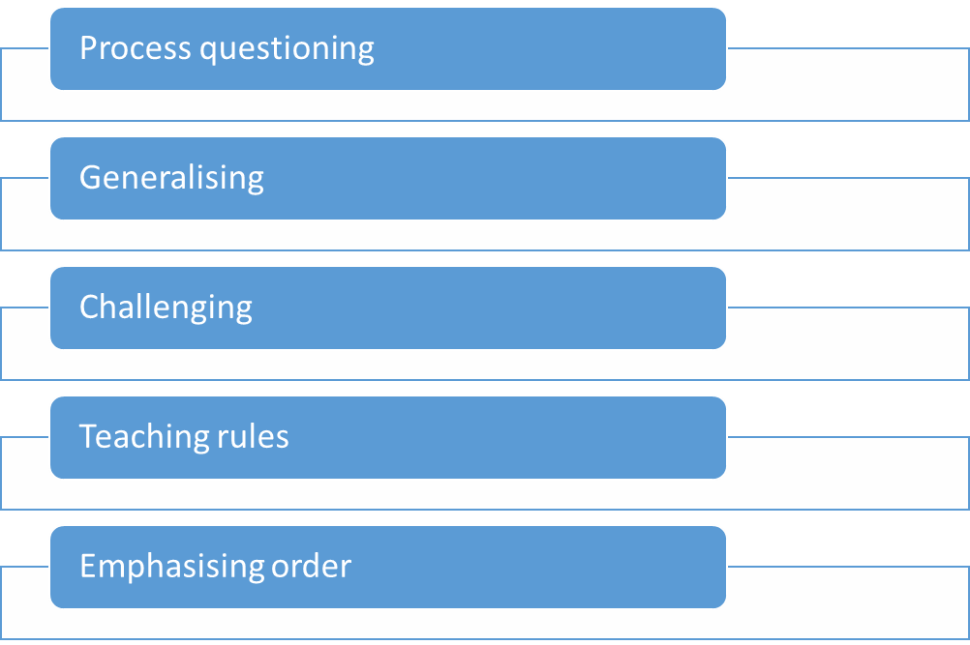

How does metacognition work in the classroom?
Hampshire Educational Psychology
Notes:
Process questioning (so that children ask questions of themselves)
Generalising (so that children see the broader application of the process in relation to their own experiences)
Challenging or requiring justification (so that children reflect on their responses and consider
Teaching about rules (so that children consider whether the rule applies to other situations)
Emphasising order, predictability, system, sequence and strategies (so that children strengthen their skills in representing problems)

Slide 21
Summary: How do we learn?
Cognitive processes
Feelings &
motivation
Metacognitive skills
Physiology/
neurology
Mediated learning experience
Hampshire Educational Psychology
Notes:
Metacognition often underused.

Slide 22

Hampshire Educational Psychology
Notes:
We are going to try and get you to have a mediated learning experience which involves some metacognition, self-talk (and peer talk) and some self-regulation.
We’re going to start by showing you a picture, which you will have 60 seconds to look at. After which you will be drawing it onto a piece of paper. Take a moment to plan how you might tackle this task which requires you to memorise an image and repeat it. This is not a test!

Slide 23
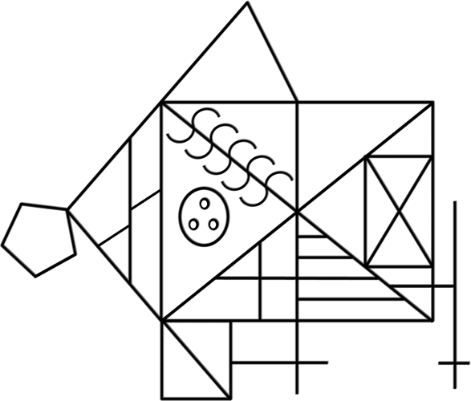
Hampshire Educational Psychology

Slide 24
Compare
Hampshire Educational Psychology
Notes:
Label this “drawing 1” - Compare your drawing to the original picture - How did it go for you?

Slide 25

Hampshire Educational Psychology
Notes:
Now – I want you to think about what you were thinking when you first looked at the picture. Why did you remember certain parts? – organisation/labelling/reminiscent of a ‘real’ object.
NOW – use those ideas to think of TWO ways in which you could remember a bit that you had forgotten. For example, you may have forgotten the circle in the middle. Does it remind you of anything? Could you complete the drawing in a different order?
TELL the person next to your new strategy. What strategy are they using?

Slide 26

Hampshire Educational Psychology
Notes:
Time to draw the picture again! Label it drawing 2

Slide 27
Compare
Hampshire Educational Psychology
Notes:
Compare your new drawing to the original picture - How did it go for you? Was it better? What helped? Why did it help? How could you do better next time?
How could this help you in other situations? With other tasks?

Slide 28
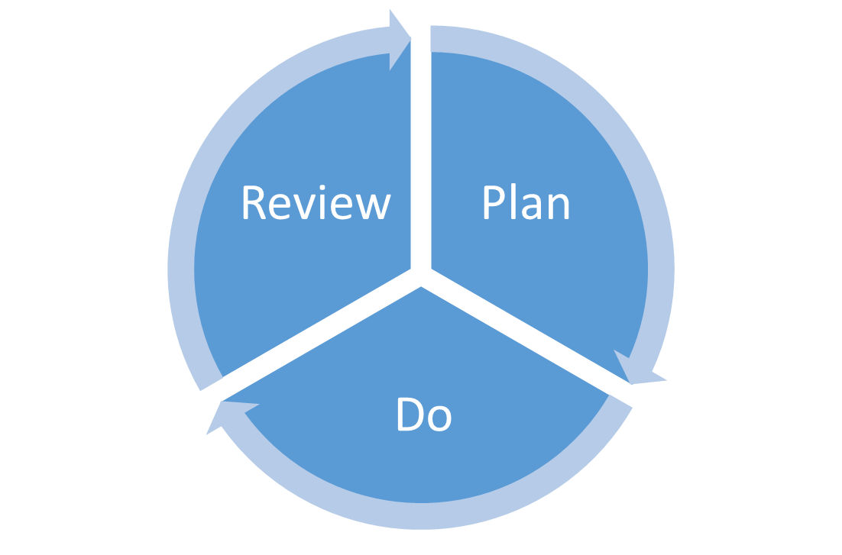
Hampshire Educational Psychology
Notes:
How does the activity we just did link to this process?
What part of this process is the metacognition? What part is the self-talk?
Is any part more important than another?
Is one part more left out than another? (review?)
Why is it important to complete all three parts in the classroom?
You planned how you might tackle the task to start with
You completed the task
You reviewed how you did
You planned how you were going to do better at the task the second time.
You completed the task
You reviewed the task at the end

Slide 29
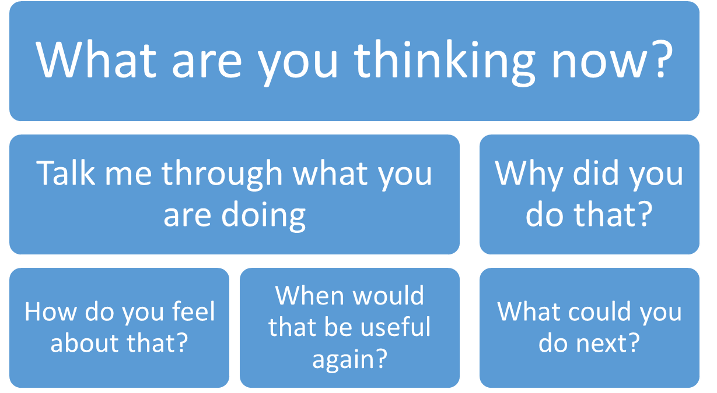
Useful questions to make learning ‘visible’
Hampshire Educational Psychology
Notes:
Ask rich questions that we (as teachers) do not definitely know the answer to. Questions about feelings, knowledge, thoughts and ideas.
Brainstorm other ‘rich’ questions as a group.

Slide 30
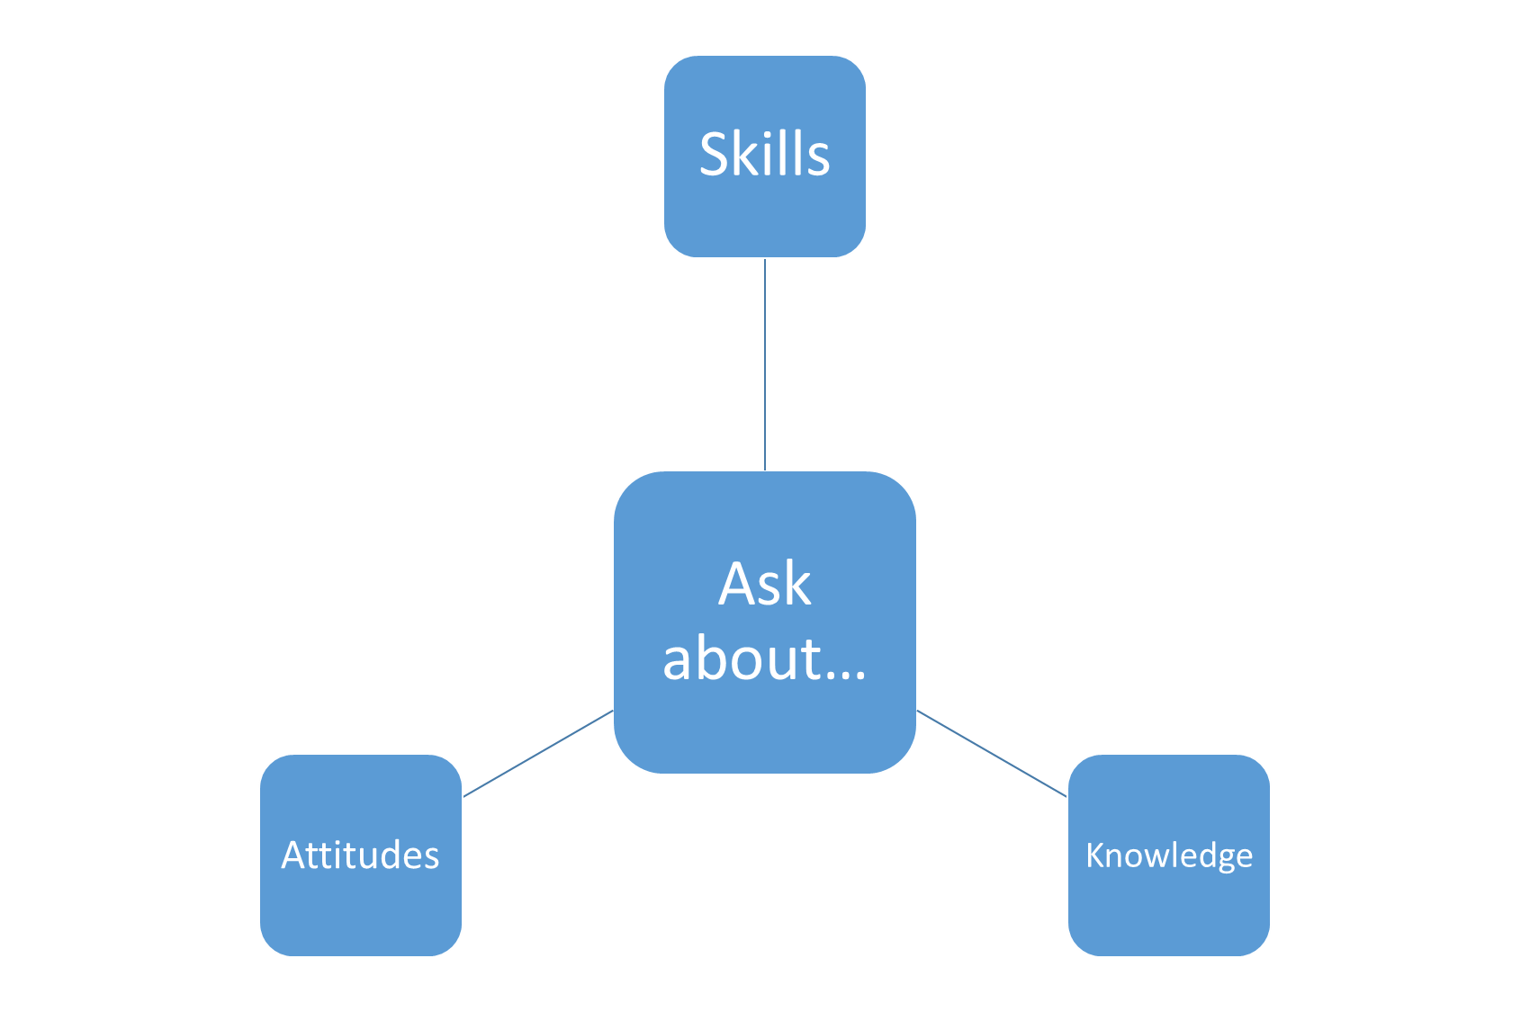
Hampshire Educational Psychology
Notes:
What skills were you using? What strategy did you use? How did you know that strategy would help? When else could you use these skills?
What helped you to worked together as a group? Why did you value that? What attitude did you all have? What would have happened if you had done this on your own, how would you have felt?
What did you know that helped you to this? When else would knowing that be useful? Did you need to know anything else?

Slide 31

Getting students to practice metacognition
Getting adults to practice mediation
You have 10 minutes.
Hampshire Educational Psychology
Notes:
In small groups – pick one adult as the mediator.
Mediator in charge of tools and activity sheet. Mediator to encourage metacognition – refer to Q’s on board/in pack. (toothpicks & marshmallows)
You have 5 minutes.

Slide 32
Getting students to practice metacognition
What did you do?
How did you think your way around the problem?
Did you try to think of something you had done before that might help?
Did you make a plan?
Did you keep checking you were along the right lines?
How did you check you were along the right lines?
Did you talk to yourself or to your group? What did you say?
How would you do it better next time?
When could you use this experience again?
Did you use any knowledge you already had to help you?
How did you feel about the challenge?
How did you feel about being in a group?
Hampshire Educational Psychology
Notes:
If you did any thinking like this about the challenge, then you were using metacognition. Also, you are now using metacognition to think about what you were thinking when you did the challenge!
Learning to think about thinking is a bit like being a the footballer and the football coach at once! Doing the job and coaching yourself at the same time.
Did you do any planning? Reviewing? Checking? Re-planning?

Slide 33

Getting students to practice metacognition
Ask ‘guiding’ questions DURING a challenging activity to help make the learning visible and encourage children to use their metacognitive skills.
Hampshire Educational Psychology

Slide 34
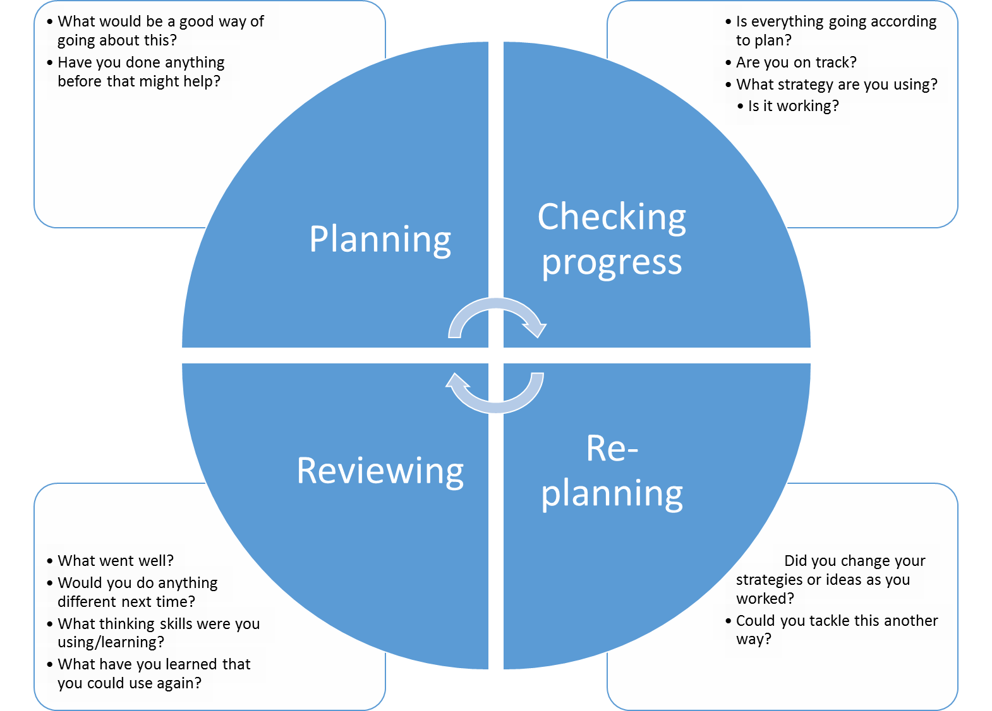
Hampshire Educational Psychology
Notes:
Guiding questions you could ask at different stages during an activity.

Slide 35

Questions and conclusions
Hampshire Educational Psychology
Notes:
Link metacognition to behaviour issues, Haring and Eton – Learning Hierarchy. Self regulation etc.
NOTE: When emailing jackie – send a separate word document with plan-do-review picture in. And frog slide for definitions. Presentation & handouts to be printed 30 times. Lucy to bring handouts in. Beth to get marshmallows and cocktail sticks.

